Slide 1
Query a DataFrame

Slide 2
Return specific rows or columns
AKA slicing and dicing
index | Name | City | Country
0 | Seattle-Tacoma | Seattle | USA
1 | Dulles | Washington | USA
2 | London Heathrow | London | United Kingdom
3 | Schiphol | Amsterdam | Netherlands
4 | Changi | Singapore | Singapore
5 | Pearson | Toronto | Canada
6 | Narita | Tokyo | Japan
Dice
Slice

Slide 3
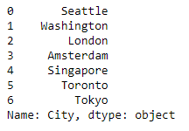
Request a single column
airports['City']
index | Name | City | Country
0 | Seattle-Tacoma | Seattle | USA
1 | Dulles | Washington | USA
2 | London Heathrow | London | United Kingdom
3 | Schiphol | Amsterdam | Netherlands
4 | Changi | Singapore | Singapore
5 | Pearson | Toronto | Canada
6 | Narita | Tokyo | Japan

Slide 4
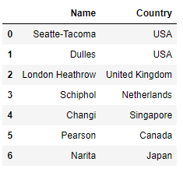
Request a list of columns
airports[['Name', 'Country']]
index | Name | City | Country
0 | Seattle-Tacoma | Seattle | USA
1 | Dulles | Washington | USA
2 | London Heathrow | London | United Kingdom
3 | Schiphol | Amsterdam | Netherlands
4 | Changi | Singapore | Singapore
5 | Pearson | Toronto | Canada
6 | Narita | Tokyo | Japan

Slide 5
iloc returns specific rows and columns by position
Use the syntax iloc[rows, columns]
airports.iloc[0,0]
will return:
Seattle-Tacoma
airports.iloc[2,2]
will return:
United Kingdom
Index | Name | City | Country
 | Column 0 | Column 1 | Column 2
0 | Seattle-Tacoma | Seattle | USA
1 | Dulles | Washington | USA
2 | London Heathrow | London | United Kingdom
3 | Schiphol | Amsterdam | Netherlands
4 | Changi | Singapore | Singapore
5 | Pearson | Toronto | Canada
6 | Narita | Tokyo | Japan

Slide 6
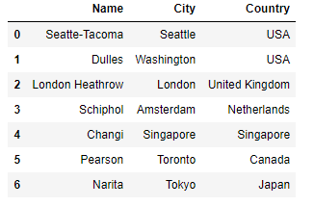
The range : returns all rows or columns
airports.iloc[:,:]
Index | Name | City | Country
 | Column 0 | Column 1 | Column 2
0 | Seattle-Tacoma | Seattle | USA
1 | Dulles | Washington | USA
2 | London Heathrow | London | United Kingdom
3 | Schiphol | Amsterdam | Netherlands
4 | Changi | Singapore | Singapore
5 | Pearson | Toronto | Canada
6 | Narita | Tokyo | Japan

Slide 7
You can request a range of rows or columns
airports.iloc[0:2,:]
returns first 2 rows and all columns
airports.iloc[:,0:2]
returns all rows
and the first two columns
Index | Name | City | Country
 | Column 0 | Column 1 | Column 2
0 | Seattle-Tacoma | Seattle | USA
1 | Dulles | Washington | USA
2 | London Heathrow | London | United Kingdom
3 | Schiphol | Amsterdam | Netherlands
4 | Changi | Singapore | Singapore
5 | Pearson | Toronto | Canada
6 | Narita | Tokyo | Japan

Slide 8
Request a list of rows or columns
airports.iloc[:,[0,2]]
will return all rows and column 0 and column 2 (Name and Country)
Index | Name | City | Country
 | Column 0 | Column 1 | Column 2
0 | Seattle-Tacoma | Seattle | USA
1 | Dulles | Washington | USA
2 | London Heathrow | London | United Kingdom
3 | Schiphol | Amsterdam | Netherlands
4 | Changi | Singapore | Singapore
5 | Pearson | Toronto | Canada
6 | Narita | Tokyo | Japan

Slide 9
loc to specify items by name
airports.loc[:,['Name',Country']]
will return all rows and the columns Name and Country
Index | Name | City | Country
 | Column 0 | Column 1 | Column 2
0 | Seattle-Tacoma | Seattle | USA
1 | Dulles | Washington | USA
2 | London Heathrow | London | United Kingdom
3 | Schiphol | Amsterdam | Netherlands
4 | Changi | Singapore | Singapore
5 | Pearson | Toronto | Canada
6 | Narita | Tokyo | Japan

